Slide 1

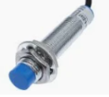
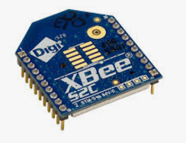
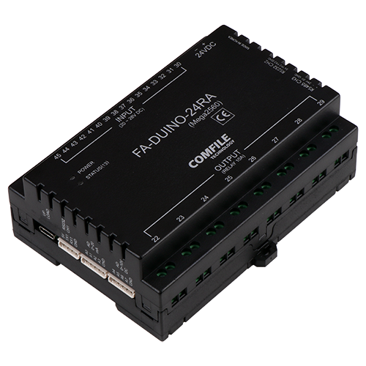
Id : 1
Id : 20 ~ 24
Buffer
Buffer
ACS
Buffer
Faduino
Faduino
Buffer
Buffer
Xbee
Xbee
Faduino
Faduino
Faduino
Faduino
Xbee
Xbee
Xbee
Xbee
Request / Response / Status stream
Xbee
2.4G Wireless
Id : 10
Id : 11
[Base Protocol ]
Stx , length, id, (payload) , CRC16-ccit, ETX
AGV #1
AGV #2
Faduino
Arduino PLC
In:16 / Out:8
Xbee
Xbee
Request / Response

